Slide 1
R101
Dinesh Barupal
dinkumar@ucdavis.edu
NIH West Coast Metabolomics Center, UC Davis, USA
Credit slides : http://stanford.edu/class/cme195/

Slide 2
Course structure
Day 1 : Overview of R world and functions
Introduction to R scripting
Day 2. ggplot graphics
Day 3. Writing R function and packaging

Slide 3

Check-list
RStudio is working
R is working
Ggplot2 is installed
Rstudio and git integration is working
Start the R Studio software
It is time for some coding

Slide 4
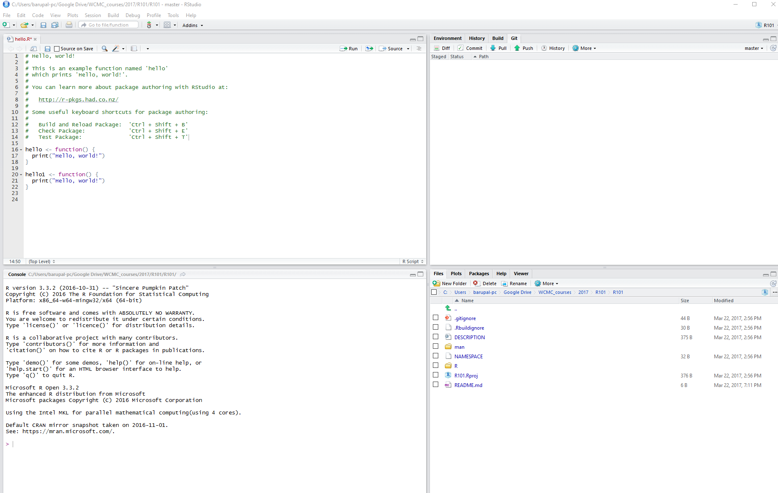
Introduction to RStudio
1+5+10

Slide 5
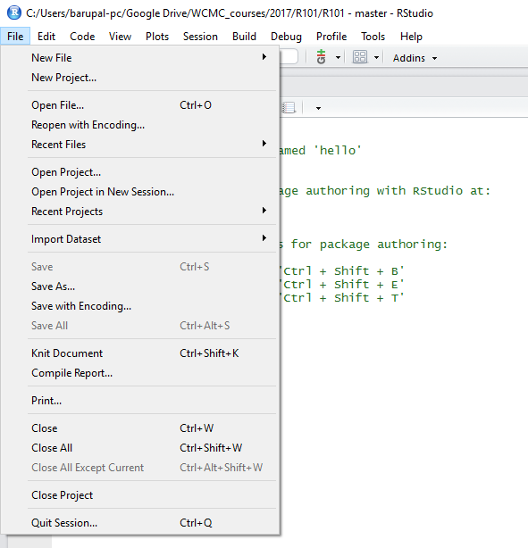
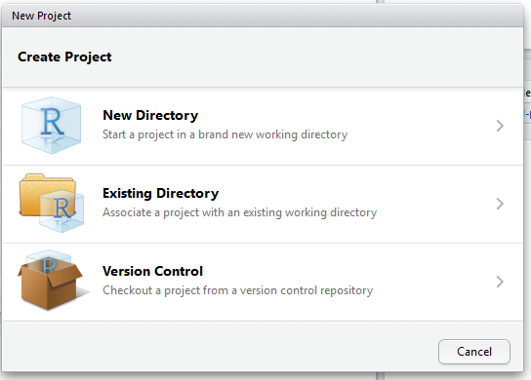
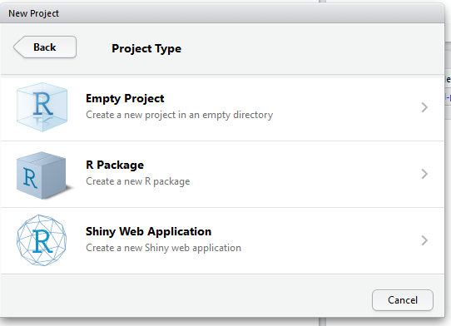
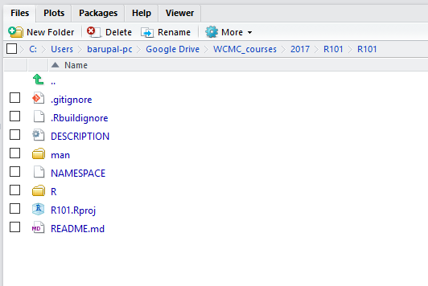
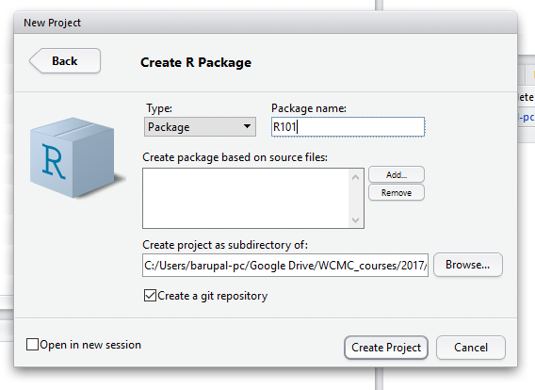
Setting up an R project
For every scientific project, you want to have an R project set-up.

Slide 6
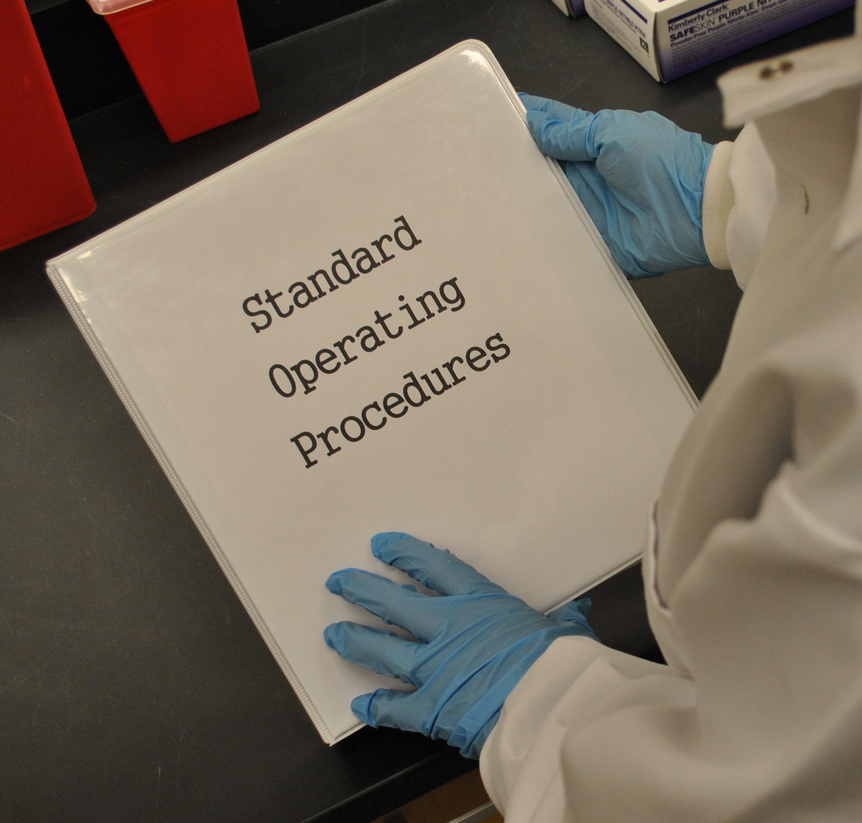


Why SOPs are important in lab ?
Why learn R ?
Level 1
Level 2
Level 3
Prep.Sample.GCTOF
Setup.Sequence.GCTOF
Prep.QC.GCTOF
Acquire.GCTOF.Data
Clean.Injector.GCTOF
Cut.Column.GCTOF
Get.GCTOF
Start.GCTOF
Process.GCTOF.Data
More detailed instructions
Filter.GCTOF.Data
In a lab SOP, we have physical objects and a detailed recipe for steps.
SOP = a set of instructions.
SOPs are critical for generating correct results.
In R, we want to make those SOPs for data processing similar to what we do in the lab.
SOP = Standard Operating Procedure

Slide 7

How R works ?
Functions
Input
Output
We want to learn what is happening in this box.
eg average
eg some numbers
There are almost 200,000 functions have been coded in R by people.
Functions in R = SOPs for data processing

Slide 8




What is an R function ?
Function in R is a set of instructions that generate an output for a given input.
Input
Think like you are going to develop/use SOPs for data processing.
Step 1
Step 2
Step 3
Step 4
instructions a, b, c, d, e, f ….
R codes
actual work
Function A
Lots of typing, sketching, coffeeing
Output
Functions in R ~ formulas in Excel (=AVERAGE (A1:A10))

Slide 9
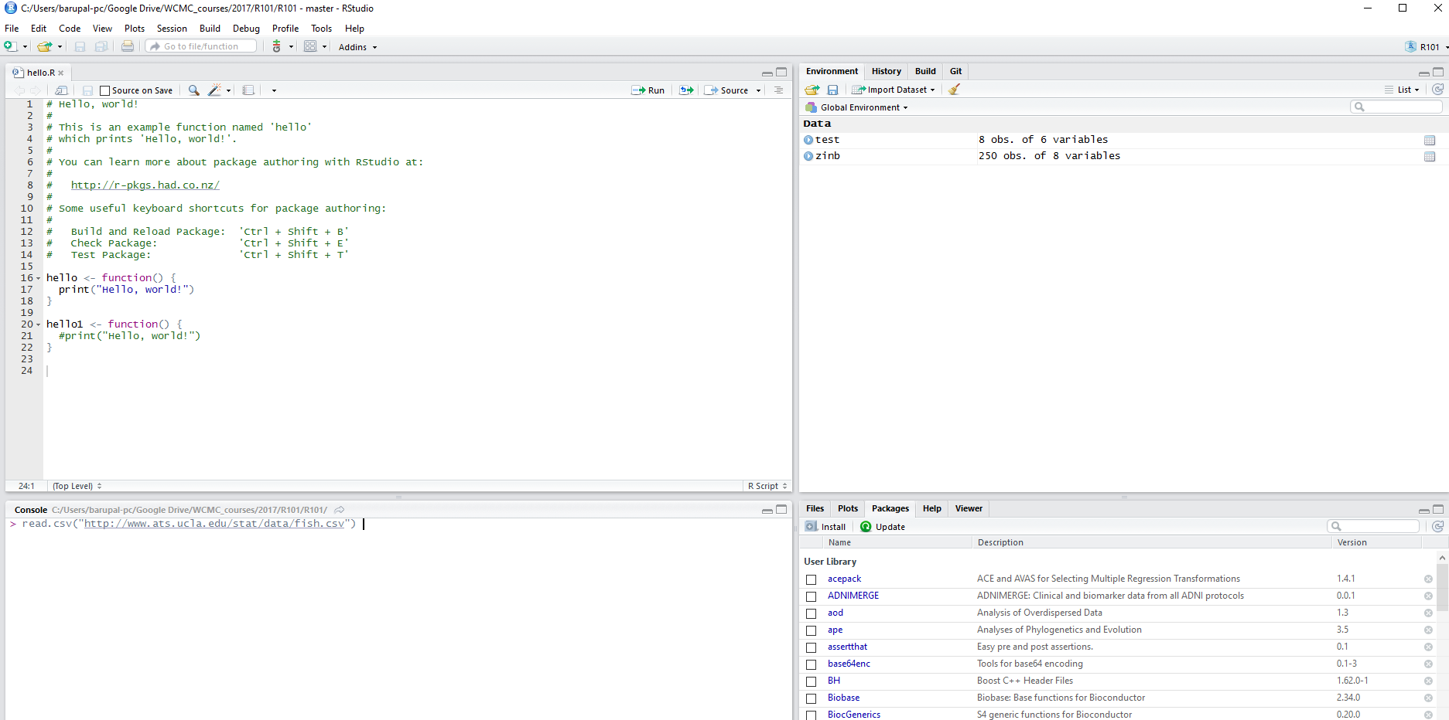
Exercise 1 : let’s use a simple function in R
read.csv("http://www.ats.ucla.edu/stat/data/fish.csv")
important tip for beginners : the word before this parentheses is the function name.

Slide 10
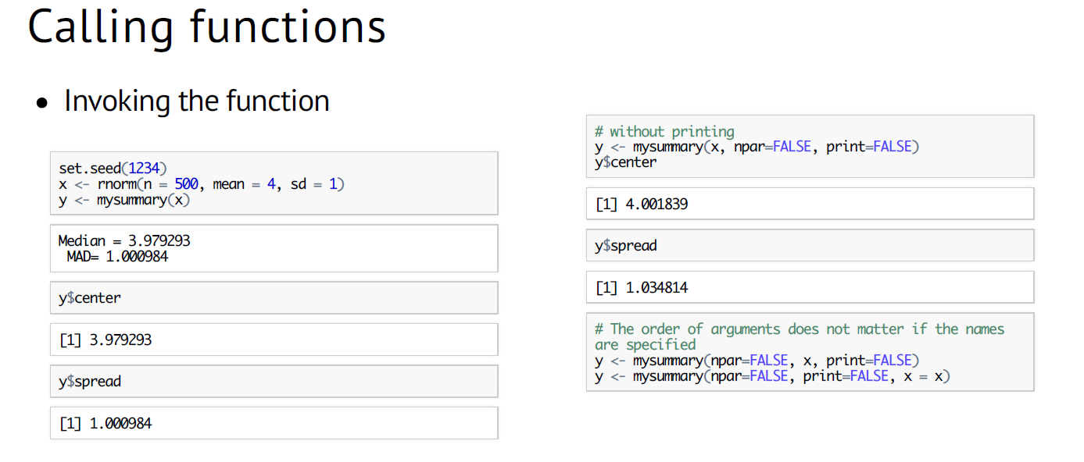
Functions need input/parameters/argument

Slide 11
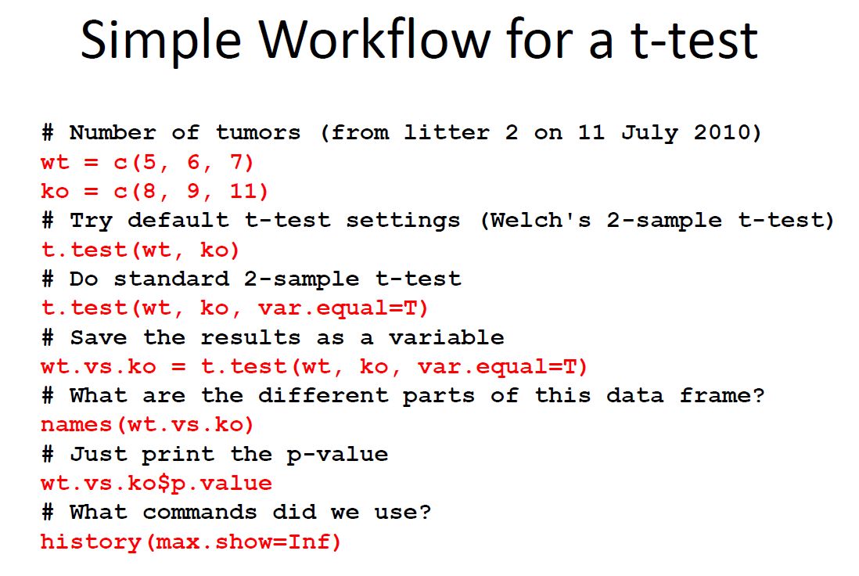
How man functions are used in this slide?

Slide 12
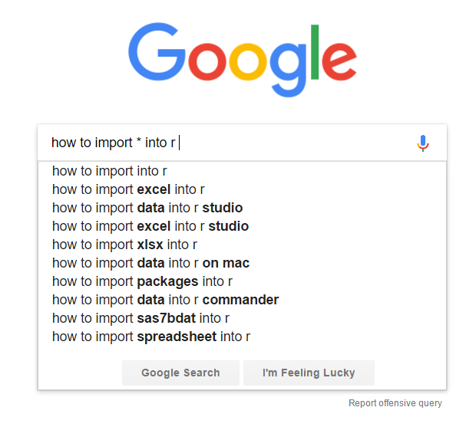
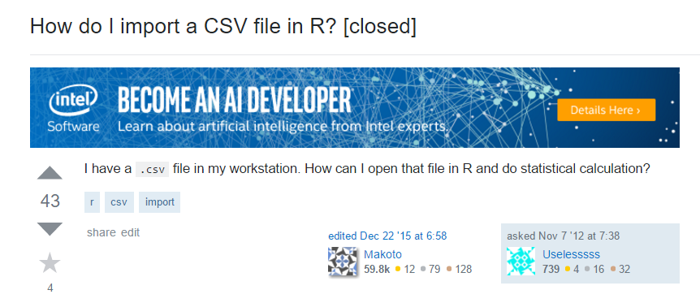

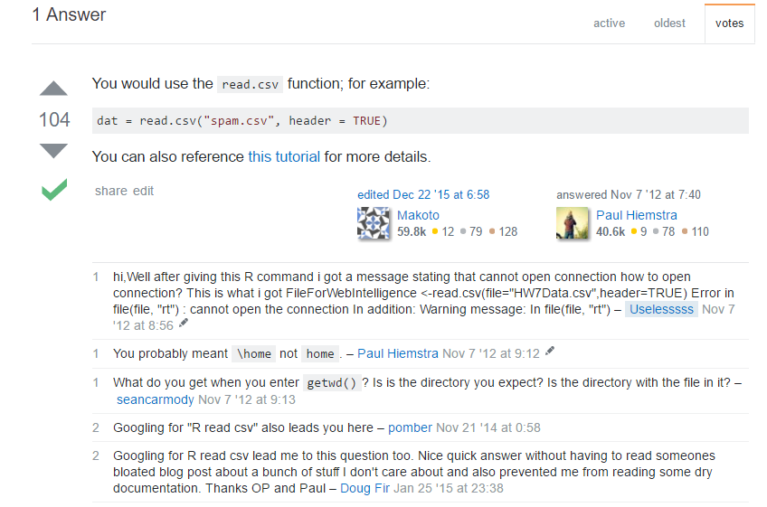
Where do I find useful functions ?
Ask – Do we have a function for …. ?
http://stackoverflow.com/questions/13265153/how-do-i-import-a-csv-file-in-r

Slide 13
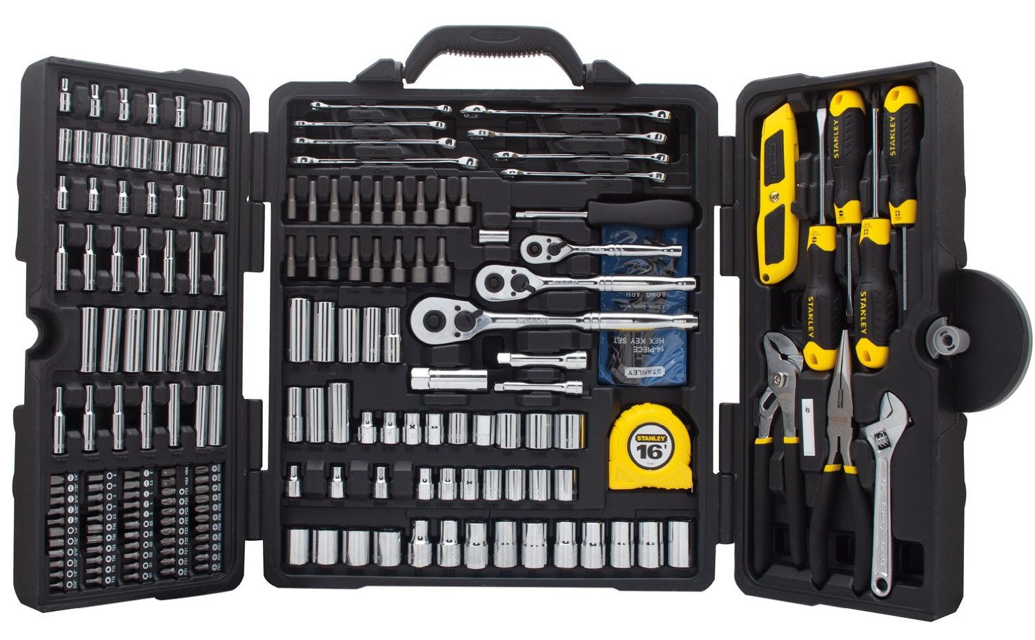
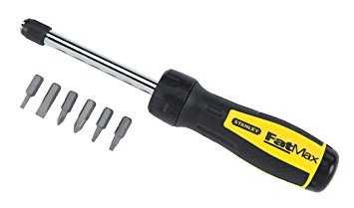
List of common functions (tasks) in R
read.table
Keep learning about new functions and adding them into your toolbox.
read.csv
write.table
length
min
max
mean
sin
median
quantile
sum
round
scale
cor
sd
tolower
plot
lm
dir
library
Every bioinformatics scientist knows a different set of R functions.
Cluster the functions by relevance such as LCMS or GCMS or Statistics
Home work :
Use google and make a list of 25 functions, other than these ones that you want to use everyday.

Slide 14
Can you Google it and figure out what this command does ?
Checkout the R cheat-sheets and reference cards for more useful commands/functions.

Slide 15



How functions are shared ?
Function 1
Function 2
Function 3
Function 4
Function 5
Script A
Function 1
Function 2
Function 3
Function 4
Function 5
Internet
Script B
Package X
txt, xml, xlsx, csv
Data
https://cran.r-project.org/
pdf, html
Documentation
https://www.bioconductor.org/
https://github.com/
Other files
Coders
Repositories
Users

Slide 16
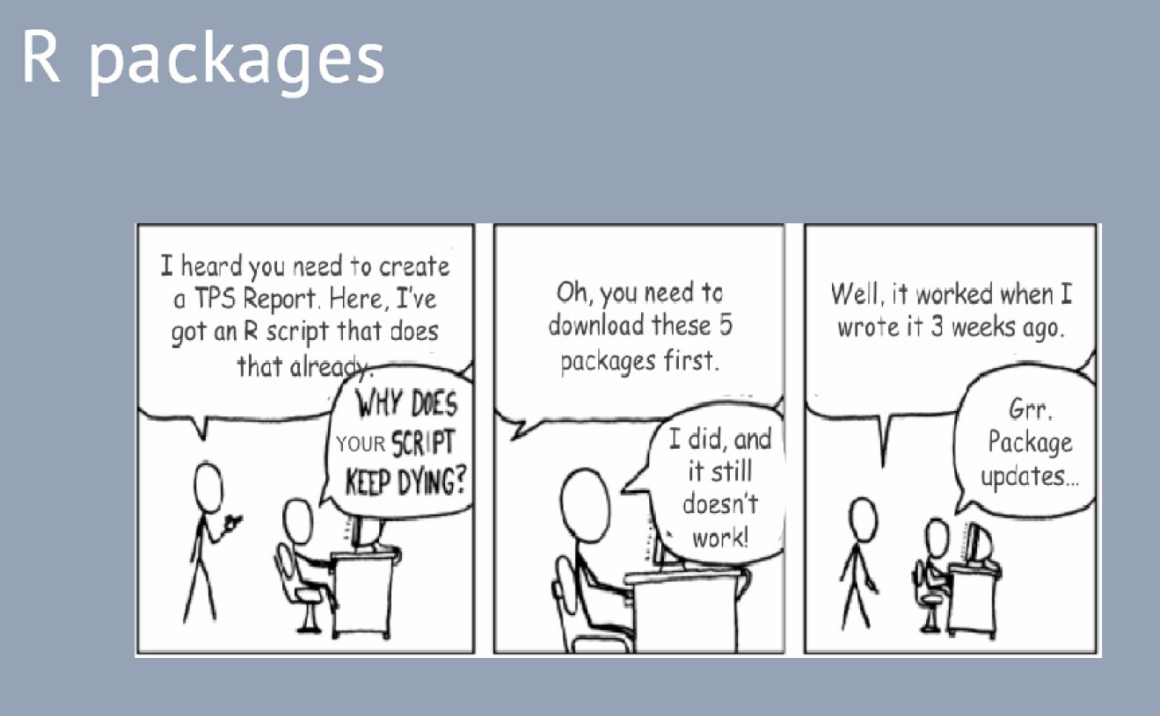
http://stanford.edu/class/cme195/

Slide 17
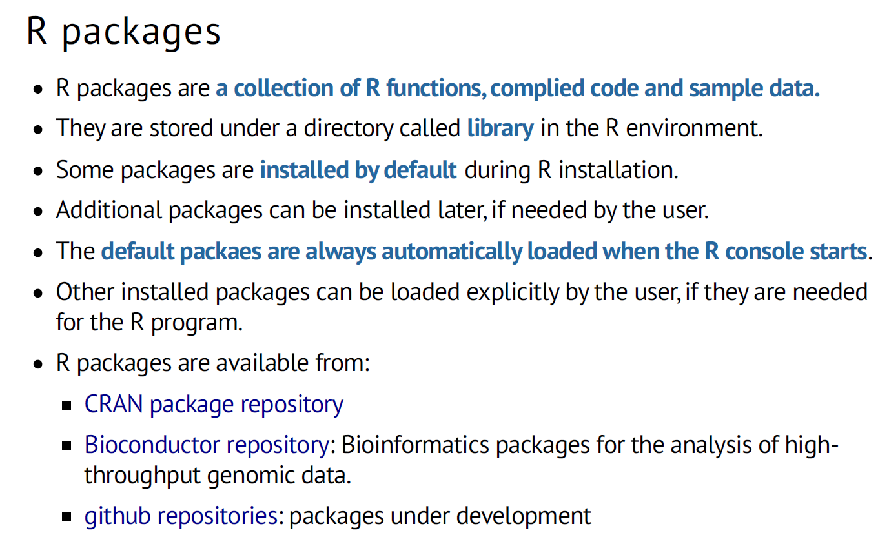
http://stanford.edu/class/cme195/

Slide 18
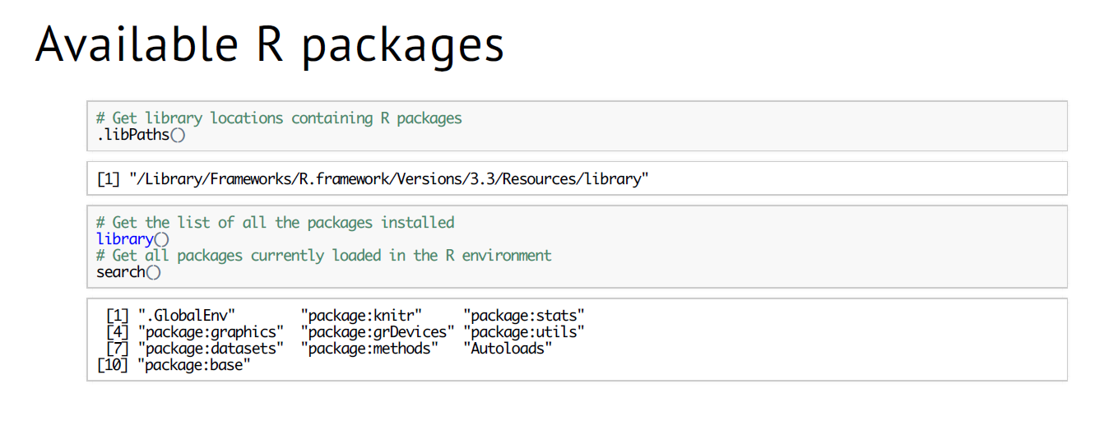
http://stanford.edu/class/cme195/

Slide 19
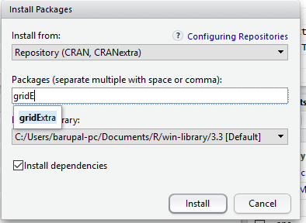
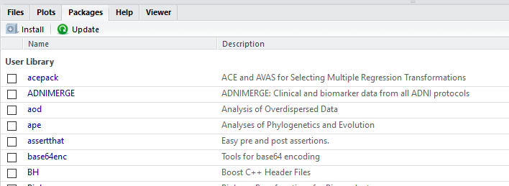
Install new R package in RStudio

Slide 20
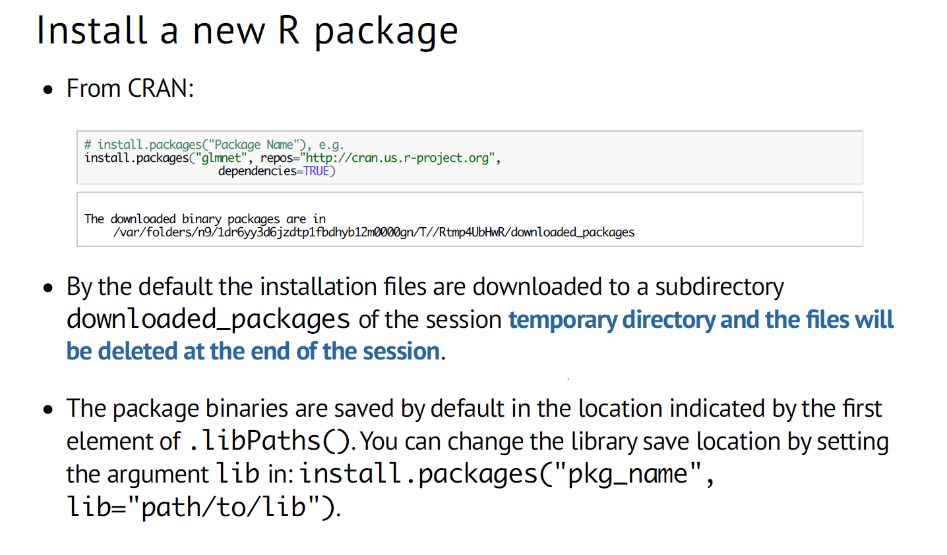
http://stanford.edu/class/cme195/

Slide 21
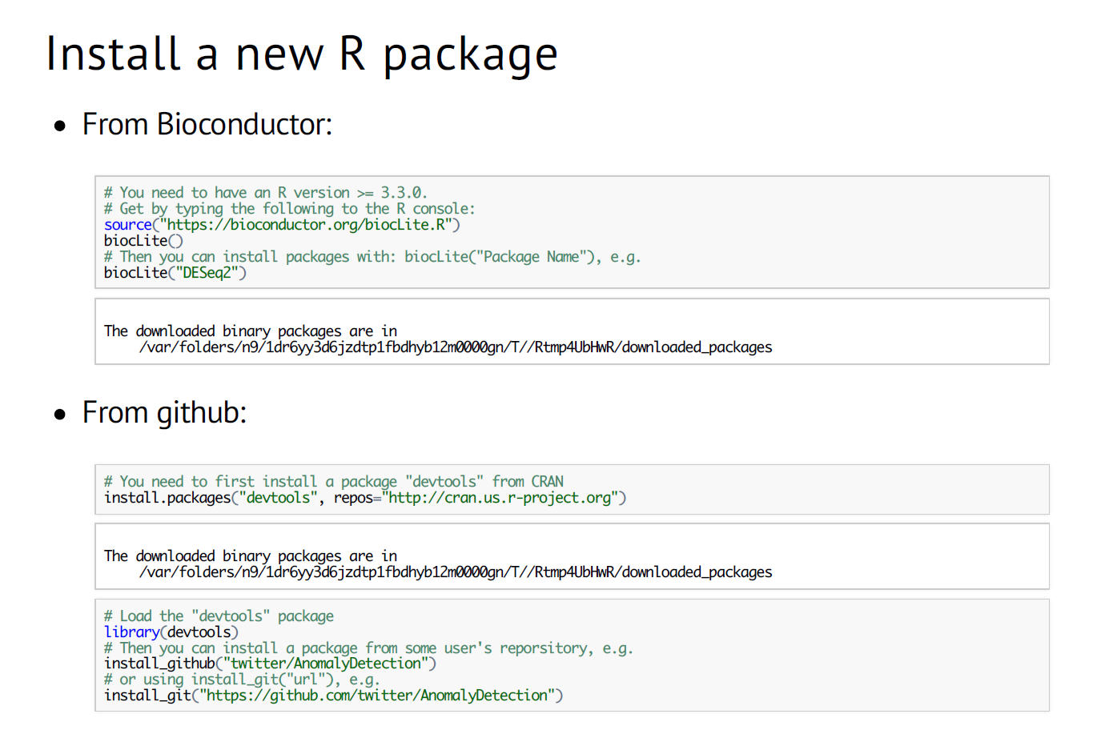
http://stanford.edu/class/cme195/

